Slide 1
IBM Emptoris and Sourcing Overview
October, 2013

Slide 2

What is Emptoris Sourcing?
“IBM Emptoris Sourcing is a Web-based software application that enables an organization to optimize the process of procurement and provides state-of-the-art capabilities for analyzing and awarding items and services.”
You can use Sourcing to …
  Create items and services that your organization wants to purchase.
  Generate detailed RFx(s) (Requests for Information / Quotation).
  Request selected supplier organizations to bid on the RFx(s).
  Analyze bids using performance factors, weights, business constraints. Scenarios are provided to perform Optimization to assist in choosing the best bids to accept.
  Award bids.
  Generate reports.

Slide 3
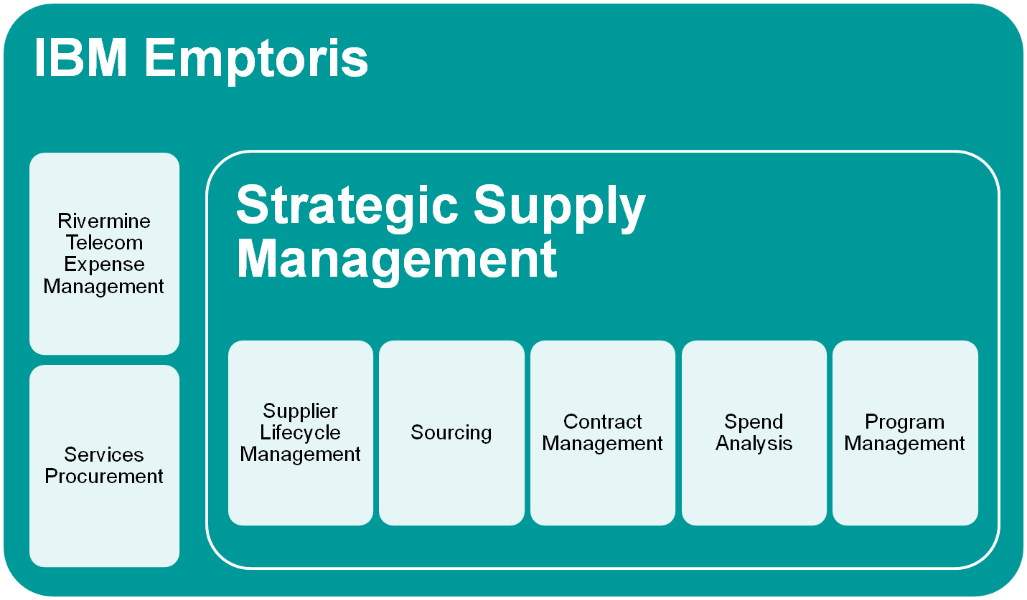
IBM Emptoris Product Offerings

Slide 4







Emptoris Strategic Supply Management
Application Suite
Supplier Management,
Risk and Compliance
Source to Contract
Enterprise and Category Spend Management
Supplier Lifecycle
Management
Sourcing
Contract
Management
Spend
Analysis
Telecom Expense
Management
Services
Procurement
Program
Management
22/04/13
Notes:
Product Suite breakdown
History
– Emptoris grew by acquisition before IBM
-- Products recently integrated in V10 version, post bluewash

Slide 5

Emptoris Solutions
IBM Emptoris Spend Analysis: Provides a complete, accurate and current view into corporate spend, enabling better decisions and delivering immediate cost savings.
IBM Emptoris Sourcing: Ensures that optimal allocations are made in all direct and indirect spend categories; from simple to complex; increases supplier collaboration and innovation; and reduces supply base risk.
IBM Emptoris Contract Management: Spans every stage of the contract management lifecycle, from contract creation and negotiation, to the management of obligations and enforcement of compliance, through contract amendment, renewal and ongoing analysis.
IBM Emptoris Rivermine Telecom Expense Management: Manages the entire communications life cycle and the analytics associated with these activities. E.g., may be paying bills for employees long departed.
IBM Emptoris Supplier Lifecycle Management: Enables complete transparency to all aspects of relationships with suppliers to address 100% of customer's supply-base.
IBM Emptoris Program Management: Provides real-time program visibility, actively managing a variety of key program tasks and capabilities to proactively monitor, measure and track savings and program objectives.
IBM Emptoris Services Procurement: Helps jump-start services procurement discipline by providing insight into the organization's services spend.
Also:
  Strategic Supply Management (SSM): Framework that encompasses most Emptoris products
  Emptoris Suite: Pre-acquisition name for SSM, but somewhat less integrated
  Virtual Supply Master (VSM): Central location for definitions of Suppliers (part of SSM)

Slide 6
Emptoris solution benefits
Spend Analysis
  Typically the first Emptoris product used by a customer, most commonly in a Services engagement
  Ability to provide a complete, correct and detailed view of corporate spend. Allows executives to make informed decisions on where to deliver immediate cost savings enabling them to be more competitively positioned.
  Categorises spend from any number of different feeds (ERP's, AP systems)
  Savings of up to 2% by Spend Analysis alone
Supplier Management
  Ability to access information about all suppliers globally in the same place.
  Defining and managing risk, which is inherent to business but understanding where risk and exposure exists is key to understanding the business.
  Ability to assess supplier performance and taking remedial action
Sourcing
  Emptoris sets the standard for driving bottom- and top-line savings.
  Ability to drive RFx and Reverse Auctions
  Savings up to 14% achieved.
Contract Management
  Gain global contract visibility. Instantly provides visibility and access to intelligence held within the contract portfolio. Apple and Conde Nast are among customers.
  One healthcare company uses Contract Management to manage 600K contracts
  Access to all of contracts from procurement, legal and operations via a centralised repository.
  Enriches data and improves accuracy enabling:
    Elimination of savings leakage
    Identification of new savings opportunities
    Reduction of maverick spend through increased compliance
  Can be applied to sales contracts too

Slide 7
A Short (Recent) History of Emptoris Suite / SSM
Version 9.0 (GA December, 2011)
Version 9.5 (GA July, 2012)
  First release after Emptoris acquisition by IBM in February, 2012 (numerous earlier acquisitions by Emptoris)
  Introduction of SSM and VSM to centralize management of Suppliers, Users, Organization, Categories
  Next generation of Supplier Lifecycle Management
  Support for IBM technology (WebSphere, DB2, Cognos, InfoSphere)
Version 10.0 (GA December, 2012)
  Single sign-on
  Further enhancements to SSM and VSM (more functionality centralized from individual applications)
  Additional integration of functions between applications
Version 10.0.1 (GA May, 2013)
  Added new functionality to migrate from pre-V10 systems to V10.x
Version “next” (GA “soon”)
  Many relatively small new functions and improvements
… plus significant other enhancements in most applications in most releases

Slide 8










Technologies Provided or Required (V10.0)
(IBM/Emptoris Software and Pre-Requisites)
Legend
Delta
IBM Emptoris Strategic Supply Management
Same
SLM
Sourcing
Contracts
Spend
PgM
8.5
10.2
Provided
8.7
VSM
VSM
VSM
VSM
VSM
5.5.15
9.7 FP6
Required
11.2.0.3.3
5.7
2008 R2
Notes:
All Products Require:
WebSphere Application Server, V8.5 Standard Edition 64-bit (limited use license included with purchase)
Contract Management Reporting also requires:
IBM Cognos Business Intelligence Platform 10.1.1 (limited use license included with purchase).
IBM InfoSphere DataStage 8.7 (limited use license included with purchase).

Slide 9

Technologies Provided or Required (V10.0.1)
(IBM/Emptoris Software and Pre-Requisites)
Legend
Delta
IBM Emptoris Strategic Supply Management
Same
SLM
Sourcing
Contracts
Spend
PgM
8.5
10.2
Provided
8.7
VSM
VSM
VSM
VSM
VSM
5.5.15
9.7 FP6
Required
11.2.0.3.3
5.7 or 6.0
2008 R2
2012 Standard
Notes:
All Products Require:
WebSphere Application Server, V8.5 Standard Edition 64-bit (limited use license included with purchase)
Contract Management Reporting also requires:
IBM Cognos Business Intelligence Platform 10.1.1 (limited use license included with purchase).
IBM InfoSphere DataStage 8.7 (limited use license included with purchase).

Slide 10




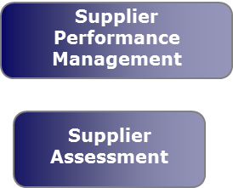
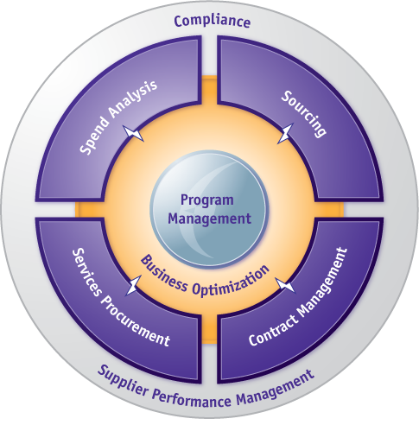
Supply & Contract Management
- Enabling Technologies
Business
Process
Strategic
Sourcing
Contract
Management
Purchase
to Pay
Supplier
Management
Sub
Process
Supply Strategy
Negotiations
Contract
Creation
Contract
Negotiation
Contract
Award
Requisition
To Pay
Contract
Compliance
Performance
Management
Supplier Development
Program Management
Enabling
Technologies
Sourcing
Contract Management
ERP
Spend to
Contract
visibility
e-proc.
Serv. Proc.
Spend
Analysis
ERP-Contacts
Integration
Procure to Pay
Control Monitoring
Legend
Other solutions
Emptoris suite

Slide 11


Sourcing Sample Use Case
Source printed Mylar™ balloons for US and Europe
Delivery locations and quantities:
  New York: 600,000 pieces
  Seattle: 400,000 pieces
  Amsterdam: 80,000 pieces
  Paris: 100,000 pieces
Delivery within 14 days after order in US, 21 days in Europe
Qualify suppliers and single source, one supplier for US and one supplier for Europe
Invite category sourcing team to observe the event and category manager to help build and schedule the event
Historical Cost: $ 0.10 (USD) each
Savings Target: min. 10%

Slide 12
Supplier Qualification Requirements
Financially Solvent
  Supplier should be financially solvent for the past 5 years
Environmental Standards
  Raw material used to manufacture the balloons must be from recycled materials
  Need explanation as to how suppliers dispose of hazardous materials
Delivery
  Suppliers should be able to deliver to all locations in US and Europe
Miscellaneous
  Suppliers must be ISO certified and hold either ISO 9000, 9001, 14000, or 14001 certifications

Slide 13
RFI Questionnaires and Questions
Questionnaires and questions
Financial
  Last 4 quarters profit percentage
  Number of FTE employees
Environmental
  EPA notices
  Recycled materials
Quality
  ISO Certified
  Number of defects per 100
Delivery capability

Slide 14
RFI Weighing and Scoring
To evaluate and to rank the responses, RFIs are ‘scored’.
Question Scores are either manually entered or automatically calculated.
Questionnaire Scores = sum of the question (weights times the scores)
RFI Total Score = sum of the questionnaire (weights times the scores)

Slide 15
 | Weight | Score | Total | Score | Total
Questionnaire 1 | 42%
Q1 | 42%
Q2 | 42%
Q3 | 16%
Questionnaire 2 | 25%
Q1 | 50%
Q2 | 25%
Q3 | 12%
Q4 | 13%
Questionnaire 3 | 33%
Q1 | 33%
Q2 | 33%
Q3 | 33%
RFI Total

Slide 16
 | Weight | Score | Total | Score | Total
Questionnaire 1 | 42% | 1.8564 | 4.42 | 2.6292 | 6.26
Q1 | 42% | 6 | 2.52 | 5 | 2.10
Q2 | 42% | 3 | 1.26 | 8 | 3.36
Q3 | 16% | 4 | 0.64 | 5 | 0.80
Questionnaire 2 | 25% | 1.3775 | 5.51 | 1.2825 | 5.13
Q1 | 50% | 7 | 3.50 | 6 | 3.00
Q2 | 25% | 4 | 1.00 | 3 | 0.75
Q3 | 12% | 3 | 0.36 | 5 | 0.60
Q4 | 13% | 5 | 0.65 | 6 | 0.78
Questionnaire 3 | 33% | 1.9602 | 5.94 | 1.8513 | 5.61
Q1 | 33% | 6 | 1.98 | 6 | 1.98
Q2 | 33% | 5 | 1.65 | 7 | 2.31
Q3 | 33% | 7 | 2.31 | 4 | 1.32
RFI Total |  | 5.1914 |  | 5.7630

Slide 17
RFQs
Lots are collections of items
Suppliers bid on
  Individual items
  Sets (e.g., “All-or-None”: one bid for entire set)
  Bundles (Price for a group of items)
  Volume Discount: Lower price(s) offered if many items are purchased
    Regular: same price for all items, but can decrease as more are purchased
    Step Volume: first N items have one price, next M another, ...
  Business Volume Discount: Total price (dollars) of items purchased

Slide 18
Auctions
Reverse and Forward
Staggered or Non-Staggered
Feed from RFQ/RFP
Forward – for example, used to sell excess inventory

Slide 19
Sourcing/Procurement Lifecycle
[Project Management (in Sourcing 9.0 and earlier) was replaced by] Program Management
Performance Management
Sourcing
Spend
Analysis
RFI
RFQ
Auction
Analysis
Contract
Award
RFP
Performance Management
Notes:
Distribute Agenda

Slide 20
Utilities
Export/Import in Sourcing allows RFx events and other objects to be downloaded, edited, and uploaded
Data Manager is the interface for managing batch jobs in Sourcing
VSM Batch Upload allows upload VSM objects needed for Sourcing

Slide 21

Sourcing Implementation
A Sourcing implementation project typically takes about 2-3 months. Projects have these phases:
Initial planning
Design (including a Configuration Workshop). This takes about 2 weeks and includes the following:
  provide basic training on Sourcing to the customer
  discuss what Organizations and Roles will be needed
  determine whether branding (customer logo etc. on screens) will be done
  decide whether RFx templates will be created, and begin creating them
  discuss special features, such as Locked Bids, and determine which will be enabled
  decide what suppliers will be loaded, and discuss the mechanism for it
Build (including application of Branding, if any). Generally 2-6 weeks.
QA, typically 1-2 weeks.

Slide 22
Sourcing Configuration
A sample SiteConfig.properties file. These settings tailor many of the functions commonly discussed with customers during Sourcing configuration workshops. This sample does not include all of the available parameters.
archive.daysBeforeAuctionArchive=15
auction.approval.indicator.autoapprove.creator=true
auction.approval.indicator.feature=true
epass.bid.createDraftBids=true
epass.buyer.category.link=true
epass.buyerSurvey.showFirstName=true
epass.buyerSurvey.showLastName=true
epass.buyerSurvey.showPhoneNumber=true
epass.default.notifications.system.name=PSO V10.0 Integrated Suite Test Site
epass.delete_userFields_with_records=true
epass.display.NDA.always=true
#epass.ecm.cmprocessor.synchronization.enabled=true
epass.ecm.lineitems_limit=10000
epass.email.aliasAddress=PSO Test Site user
epass.email.useAlias=true
epass.historical.cost.update=true
epass.item.aggregate.quantity.collection=true
epass.item.source.link=true

Slide 23
Sourcing Configuration, cont.
#epass.language.default=en,de,es,fr,it,pt,zh,z1,ja,tr,ru,nl,pl
epass.language.default=en
epass.languages.build=en,de,es,fr,it,pt,zh,z1,ja,tr,ru,nl,pl
epass.languages.include=en,de,es,fr,it,pt,zh,z1,ja,tr,ru,nl,pl
epass.module.enabled=AdvancedAuction\=yes,SealedBidRFQ\=yes,RFI\=yes,sce\=yes,Report\=yes,wft\=no,con\=yes,DemandAggregation\=yes,ForwardAuction\=yes,BuyerSurvey\=yes,RFP\=yes,spend\=yes,sas\=no,CreativeNegotiation\=yes,DutchReverseAuction\=yes,DutchForwardAuction\=no,notice\=no,dashboard\=yes
epass.NDA.required=true
epass.request.buyer.businessunit=true
epass.request.buyer.enable=true
epass.request.supplier.enable=true
epass.rfq.aggregatation.enabled=true
epass.rfx.default.rfx_view_mode=1
epass.RFx.supplierInvitation.recordLastActionDate=true
epass.rfx.uom.create=true
epass.show_user_module_visibility=true
epass.site.url=http\://psosourcing.emptoris.com
#epass.spend.compliance.enabled=true
#epass.spend.multiple.cubes=false
epass.supplier.category.link=true
epass.update_profile.days=1
epass.user.moduleVisibility.enabled=true
form.detail_message_template_content.body_length=32000
is.reasoning.performed=true

Slide 24
Sourcing Configuration, cont.
supplier.performance.management.enabled=false
#Controls whether an RFx import for a template event can include items.
epass.integration.items_allowed_in_template=true
#Whether to show SUPPLIER attachment details
epass.rfx.show_attachment.lockedbids=true
epass.recommended.attachment.size=20
epass.bid.recordTrailofProxyBids=true
epass.rfp.one.envelope.bidding.enabled=true
epass.rfp.two.envelope.bidding.enabled=true
epass.show.suppliers.with.bid.for.envelope.bidding=true
epass.bid.sealed.locked.canLock=true
epass.rfi.locked.canLock=true
epass.rfx.locked.defaultIsLocked=false
epass.rfp.locked.bidding.enabled=true
epass.rfp.locked.defaultIsLocked=false
epass.rfp.unlocked.bidding.enabled=true
epass.seeded.users.update_details=true
epass.messaging_business_user.first_name=PSOTEST\: Messaging
epass.messaging_business_user.last_name=User Name
epass.notification_business_user.first_name=PSOTEST Notification
epass.notification_business_user.last_name=User Name
epass.notification_business_user.email=jhartfor@us.ibm.com
notification_expiration_day=40

Slide 25
Emptoris V10.0.1 and Migration
Prior to V10, Emptoris products have stored user/common data in their own application Databases in their own formats.
As of V10, that data is stored in VSM in a different format.
V10.0 did not include a migration capability, so users on V9.x and earlier could not move to V10 (while keeping their data).
V10.0.1 added migration capability that extracts and transforms application data to VSM format. Two scenarios:
  Migration 1: V7.x onwards to v10.0.1
    Supporting legacy applications / Suite (Sourcing, Contract Management and Spend Analysis) to migrate to 10.0.1
    Needs Services, AppMgmt and Extraction Tool to do this migration
  Migration 2: V10 to v10.0.1
    Out of box; will happen automatically when SSM V10.0.1 is started
    A customer on V10 uses VSM and therefore there is no need to do any common data migration as for Migration 1.

Slide 26
Migration Assumptions
Migration is performed on same type of Database
Primary database focus of Migration will be Oracle 11g/11.2.0. (Most of the existing customers are on Oracle DB.)
Core Migration considers Sourcing, Contract Management, and Spend as the primary targets.
Migration focuses on loading the data in right format, and not on data clean-up. Data cleansing can be done separately and should be kept independent of migration.
Customers need Services help to do this Migration
SLM Classic to SLM-NG is a separate process, and is not part of this standard migration
Legacy suite migration with SLM is a separate project, and is out of scope as core deliverable.
Extraction Tool is built and shipped independently of core product

Slide 27
Migration Notes for Sourcing
New roles may be assigned to users in VSM based on permissions in SSM
Users need to change their passwords when they log in for the first time after migration
Users with expired passwords will be moved to VSM in deactivated state
Security question and answer are not preserved across migration
Email for users/contacts is mandatory. If not found, system populates email as missing_data@missingdata.com

Slide 28
Migration FAQ's for Sourcing
Does Migration deal with Business Units?
  Yes, Sourcing migrates Sourcing business Units as child org in VSM.
Does Migration deal with user & Business unit links?
  Yes, Migration will migrate user & Business unit links to VSM. Going forward user & business unit links are established via VSM and not in Sourcing.
Does Migration deal with user & category links?
  Yes, Migration will migrate user & category links to VSM. Going forward user & category links are established via VSM and not in Sourcing.
Does migration, carry forward Self Service Model organization and its multiple Catalogs?
  No. This functionality is obsoleted in V10.0.1. There is no migration planned for this data.
  Users from self service org will not be able to login.

Slide 29
Migration FAQ's for Sourcing, cont.
Is Project Management data getting migrated in V10.0.1?
  No. This functionality was obsoleted in V10.0, through Sourcing Module. There is no migration planned for this data in VSM.
  However, User can view the existing projects in Sourcing application, using config switch.
Are Categories and translated Categories in multiple languages getting migrated from Sourcing?
  Yes. Migration scripts will extract language categories. Import process needs to follow a “ Category language setup” process to migrate this data correctly.
Can setup have Category language translation for all 9 suite languages?
  No. Only 5 languages can be supported in Category translations, from set of VSM supported languages i.e. English, French, German, Italian, Spanish, Traditional Chinese, Simplified Chinese, Brazilian, Portuguese, Japanese.
Sourcing supports extra languages such as Dutch, Polish, Slovenian, Russian, Swedish & Turkish. What happens if a customer has Category from sourcing’s extra language?
  It will be an issue in migration, because these are not supported across suite are.

Slide 30
Migration FAQ's for Sourcing, cont.
What happens with a user whose “Home Page” is set to “Project Management Console”?
  Because Project Management from Sourcing is obsoleted in V10.0, these users will be set with “Portal Page” as the home page.
What happens with users who were assigned with “Feedback Survey” as the assigned role?
  Because SPM from Sourcing is obsoleted in V10.0.1, “Feedback Survey” is also obsoleted; these users will be brought into VSM as disabled for Sourcing and assigned Buyer Observer role.
What happens with users who were assigned “Spend Role” in Sourcing?
  These users will be brought into VSM as disabled for Sourcing and assigned Buyer Observer role.
Do you have custom Roles in your setup?
  Custom roles will get extracted as groups. And importing them will create a new group in VSM with RemoteId (internal Id saved ).
  Ensure that esp_Roles.properties is updated to add this new custom role .
  e.g. 200=New Custom Role (200 is remote Id of that role and New Custom Role is name of that Role in Sourcing)

Slide 31
Migration FAQ's for Sourcing, cont.
How do we overwrite standard custom Migration roles in Sourcing?
  Update the entry in esp_SSMRoleMapping.properties
  E.g. change default setting 101=Sourcing Buyer Application Manager to 101=Sourcing Buyer Application Manager with Create external User

Slide 32

Questions?

